Slide 1

RMHI PALS
Thursday 6th June 10AM-1PM

Slide 2
Disclaimer
We are not professionals.
We’re all students here so don’t just feel free to chime in every once in a while,
we’d go as far as to encourage you to criticise us as much as you can!
You’re all free to discuss with each other in groups if you’d prefer but please don’t be too loud to disrupt those around you.

Slide 3
Concepts I will not be covering
(but you should really know them well!)
Structure of a good research question
Population vs sample
Parameters vs statistics
Types of distributions
Constructs, measures and scores
Properties of an estimator

Slide 4
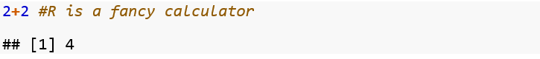
Basics of R: Basic Operators
+, addition
-, subtraction
/, division
*, multiplication
^, exponentiation

Slide 5
Basics of R: Logical Operators
==, is equal to
!=, is not equal to
>=, is greater than or equal to
<=, is less than or equal to
>, is greater than
<, is less than
| is OR
& is AND
! is NOT

Slide 6
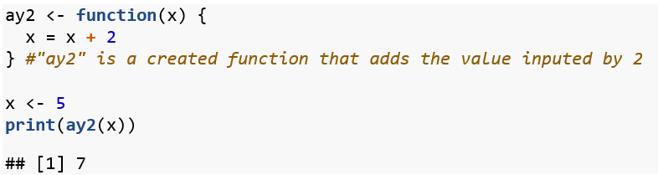
Basics of R: Functions
Functions are ways to make R do things!

Slide 7
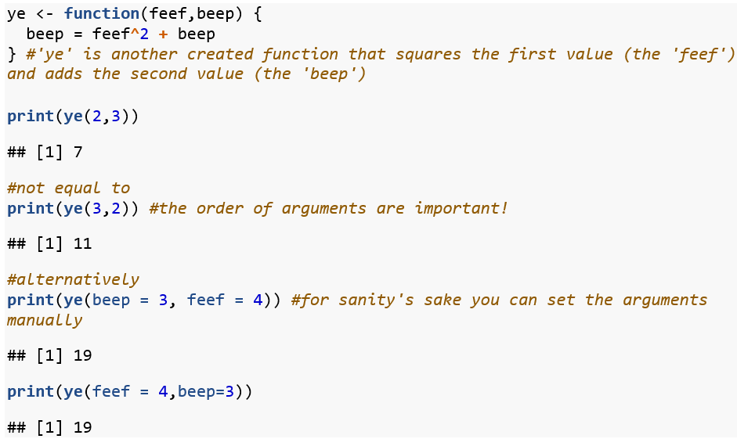

Slide 8
Basics of R: Variable types
Numeric = R considers numeric variables numbers.
Characters = Also called ‘strings’, can contain letters or numbers.
Logical = True/False, lot more powerful than you think.
Any variable with one or more values is called an (atomic) vector.
The values in a vector is called an element.

Slide 9
Basics of R: Packages
R allows for the installation and usage of ‘packages’.
Packages contain functions and other fun-things that augment R in some way.
You can install packages and load them up to use functions that are relevant for what you’re aiming to accomplish with your data wrangling, data visualisation, data analysis, etc.
Example: catterplots

Slide 10
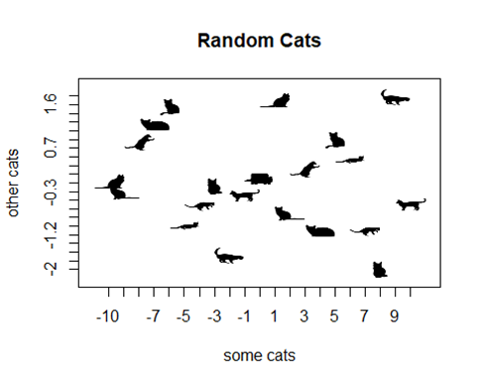
Notes:
mrow <- multicat(xs=x, ys=rnorm(21),
cat=c(1:11),
catcolor=list('#000000FF'),
canvas=c(-0.1,1.1, -0.1, 1.1),
xlab="some cats", ylab="other cats", main="Random Cats")

Slide 11
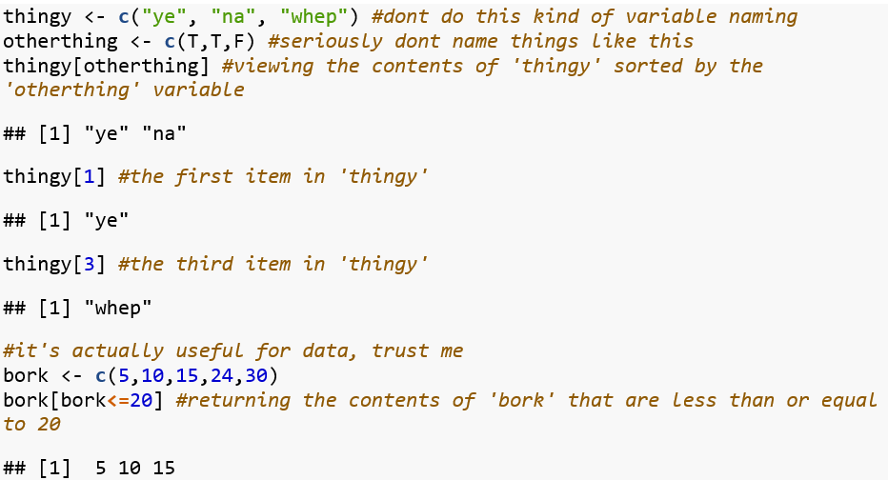
Basics of R: Wrangling with Logical operators
Square brackets and logical expressions can be extremely powerful!

Slide 12
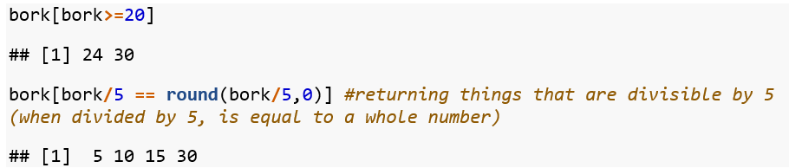

Slide 13
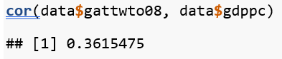
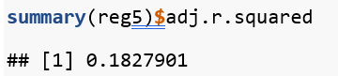
Basics of R: Dataframes
Data-frames are variables combined together.
Data-frames can be conceptualised as a bunch of vectors mashed together into a dataset.
The $ can be used as an operator to select particular variables.

Slide 14
SidebaR: Documentation
Wise words from the amazing Danielle Navarro:
“Your worst enemy is you 6 months from now.”
Or in my case, probably 6 days from now.
Documentation to describe what portions of your script do (with the #) will SAVE YOUR SANITY.
R ignores everything after the #, so use it away!
You could also use R markdown for more intensive documentation.

Slide 15
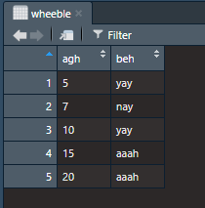
Quick R Exercise:
Consider this 5-entry data frame:
What will the output be when I input:
wheeble$agh[beh!=”nay”]
wheeble$agh[beh!=”hah”]
wheeble$beh[(wheeble$agh/2==round(wheeble$agh/2,0)) == T]

Slide 16
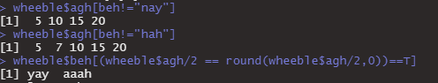
Solution
These expressions combine logical operators and data frame variable notation.
I hope this example gives you an idea of the many ways we can manipulate a data frame.

Slide 17
Core Concepts: Manipulating scores
4 different types of scores:
Raw/Observed scores: untouched metric from measure,
Deviation score: scaled to the metric mean,
Standardised score: scaled to a specified mean and a specified amount of standard deviations per unit,
Z score: a type of standardised score with mean 0 and 1 standard deviation per unit.

Slide 18
Core Concepts: Random Variables
A variable consisting of the set of all possible outcomes defined by one or more population parameters.
I understand RVs to be the perpetually unknowable variable defined by the existing parameters of the natural world.
If it’s easier to grasp as an infinite set ranging from infinity to negative infinity, that may be correct in some situations.

Slide 19
Core Concepts: Random Variables
What we do know is that they come in two flavours:
Continuous (e.g. height, temperature, etc.) If naturally occurring decimals make sense- it’s a continuous variable (13.4 cm, 34.2 celsius)
Discrete (or Factor in R) (e.g. measure responses, no. of errors made, etc.) Ones where naturally occurring decimals make no sense. Categorical variables are a type of discrete variables.
What matters is that we know these numbers behave differently; don’t take continuous variables to be discrete and vice versa.

Slide 20
Sidebar: Standard Error
The standard deviation of a sampling distribution is called a standard error- why?
A way to think about this is that a sampling distribution talks of the set of different statistics you can get, so the spread in that distribution is the typical amount the statistic is different by, i.e. the typical amount of error from your computed statistic.

Slide 21
Sidebar: Observed Test Statistic
An application of the sampling distribution (I believe) is the calculation of the observed test statistic.
Observed Test Statistics (Tobs) are the statistics computed to encapsulate your data which are then compared to the corresponding theoretical probability distribution to construct a p-value.
This is your t-statistic, chi-square statistic, F-statistic, etc.
Corresponds with a p-value (more on that in a bit).

Slide 22
Core Concepts: Theoretical Probability Distribution
Sampling distributions are cool, but these are even cooler- because they exist by mathematical functions and don’t need an unfeasible amount of resources to make.
A standardised sampling distribution is equivalent to a theoretical probability distribution.
Fitted normal curves are equivalent to sampling distributions- so we have the distributions that have the same properties as the sampling distributions without actually needing to construct them manually.

Slide 23
Core Concepts: NHST
Good ol’ null hypothesis significance testing.
So what’s a p-value? The p-value is a widely used statistical inference method to evaluate statistical hypotheses (e.g. null hypotheses).
Note that statistical inference is different from scientific inference, scientific inference may involve statistical inference, but you cannot say that a statistical inference implies a scientific inference. No. The tools we use are not infallible and reflects the researcher’s intentions of inferring ideas from data.

Slide 24
Core Concepts: NHST
The typical method to reject the null hypothesis is:
Set null and alternative hypotheses,
Decide the alpha (typically .05 and consequently the critical test statistic(Tcrit)),
Calculate the observed test statistic (Tobs) from relevant sample stats,
Find the p-value corresponding to the Tobs of the data,
If p < alpha, reject (consequently if |Tobs| > |Tcrit|, reject) otherwise, retain.

Slide 25
NHST: What the p-value is NOT.
It’s NOT:
The probability of the scientific hypothesis being true,
The probability of your alternative statistical hypothesis being false,
The probability of your null hypothesis being true,
The probability of your null hypothesis being false,
The probability of observing your sample statistic.

Slide 26
Core Concepts: Confidence Intervals (CIs)
CIs are a function of p-values (and of standard error in general)
The margin of error (interval area) is defined by what we don’t consider to be statistically significantly different- and therefore ‘plausible’.
Remember, the sampling distribution represents multiple samples- and values within the confidence interval are ‘plausible’ as a function of the preset alpha value and standard error of the sampling distribution to determine what values are ‘plausible’ in other samples.
In other words, it depends on the standard error value and our preset alpha criterion value.

Slide 27
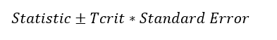
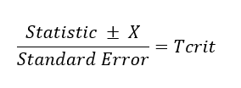
CIs
The ‘typical’ way to formulate CIs are:
However, I think it might be easier to conceptualise CIs if you formulate them as:
With X representing the null hypothesised value and eventual confidence interval values.

Slide 28
CIs
Note that this expression is equivalent to a z-score and note the absence of absolute value (|Tcrit|), we want both sides of the Tcrit. Assuming alpha = .05, Tcrits = 1.96 and -1.96. We know three constants: the statistic, its standard error and then our a priori critical test statistics, and now we work backwards to find the two X values.
What I want you guys to take away is that CIs represent a range of null hypothesised values which cannot be considered statistically significantly different from your observed statistic.

Slide 29
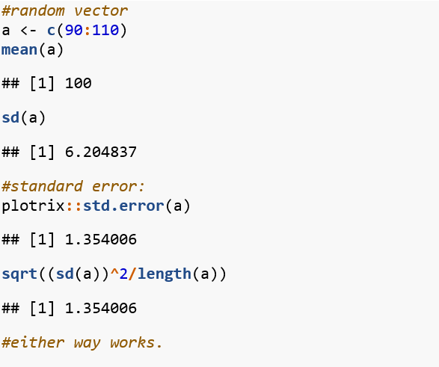
Worked Example

Slide 30
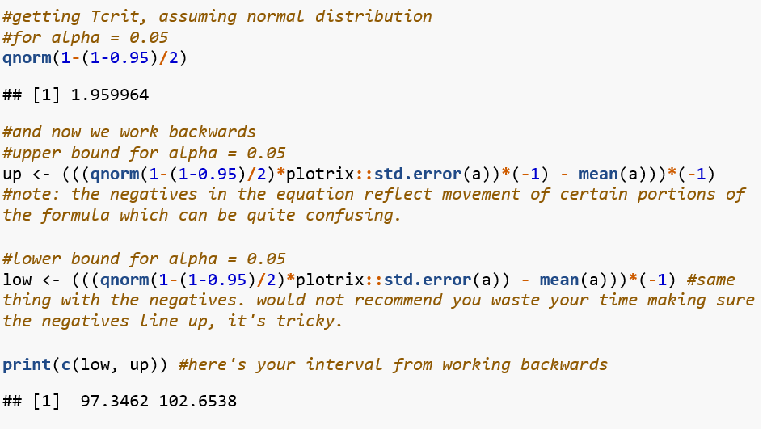

Slide 31
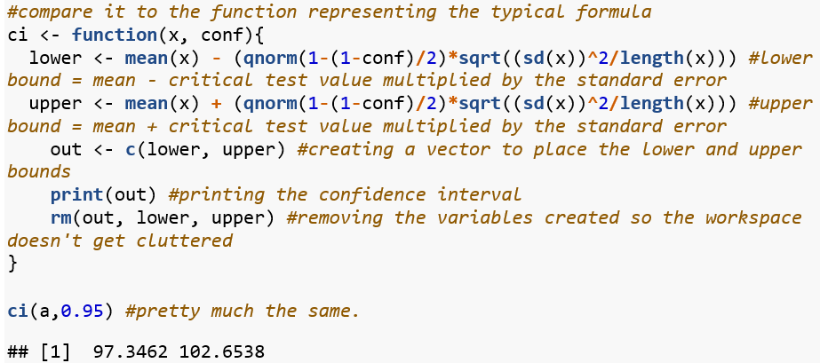
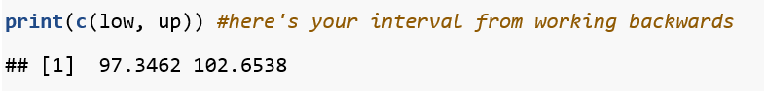

Slide 32
Sidebar: Alpha criterion
These serve to control type-1 error rates, and define boundaries of statistical significance.
P(Rejecting H0|H0 = T) is what the alpha represents.
In the metric of sampling distributions, the alpha criterion is directly equivalent to the critical test statistic (the value that the observed test statistic has to exceed to declare statistical significance).

Slide 33
Core Concepts: Effect Size
Last one. Hurray!
Kind of an ambiguous term to refer to a method of describing the strength of a relationship.
E.g., Pearson’s r, Cramer’s V, standardised regression coefficients or R-squared.
Effect size measures can also have their own conditions where they are robust or not, no matter whether or not your design has a statistical assumption that needs to be satisfied.
E.g., Bonett’s delta, Hedges’ g

Slide 34
Association
Systematic co-occurrence.
‘These things occur together’ is what association represents.

Slide 35
Association: Continuous Variables
We use pearson’s correlation coefficient (I just call it Pearson’s r)
But first, scatter-plots and covariance!
A neat game: http://guessthecorrelation.com/

Slide 36
Association: Covariance
The covariance of the plots directly refer to how two variables vary together- how much a sample varies on two variables together. In other words, it can tell you the strength (in its own metric) and direction of how much a sample systematically varies on two variables.
But here’s a problem- it’s in its own metric, so how do we change it to be meaningful?
We standardise it!
And that is what correlation is- standardised covariance. Or to be specific, covariance of z-scored variables.

Slide 37
Association: Pearson’s r
r ranges from -1 and +1 and captures the strength and direction of association between two continuous variables.
‘r’ is the sample coefficient, the population coefficient is symbolised as rho (ρ).

Slide 38
Association: Categorical Variables
Contingency/Frequency tables!
The Cramer’s V statistic is essentially a rescaled chi-square statistic to fit between 0 to 1.
The higher the V the stronger the association.
No direction since the chi-sq stat doesn’t have a direction.

Slide 39
Association: Odds
Odds are the probability of something occurring relative to it not occurring.
i.e. 4:1 odds mean 80% to 20%, 9:1 odds mean 90:10.
20% chance it’ll rain = 4:1 odds of not raining. (4 times more likely for it to not rain than it is to rain)
10% chance I’ll bring my umbrella = 9:1 odds of not bringing my umbrella (9 times less likely for me to bring my umbrella than me not bringing my umbrella)

Slide 40
Association: Odds Ratios
Odds ratios (OR) take it a step further. The OR represents the ratio of two odds:
(9/1 / 4/1) = 2.25
It is 2.25x more likely for me to not bring my umbrella when it doesn’t rain.
The reciprocal holds true too
4/9 = 0.44 (4/1 / 9/1)
It is 0.44x more likely for me to bring my umbrella when it doesn’t rain.

Slide 41
Association: Odds Ratios
Provided you don’t mess with the raw numerical values (never mess with raw values!!), you can twist your odds ratio around to brain-numbing ways.
1/9 / 4/1 odds ratio of me bringing my umbrella when it doesn’t rain
It is 1/36x more likely for me to bring my umbrella when it doesn’t rain relative to not bringing my umbrella when it does.
9/1 / 1/4 odds ratio of me not bringing my umbrella when it rains
It is 36x more likely for me to not bring my umbrella when it rains relative to bringing my umbrella when it doesn’t rain.

Slide 42
Couple o’ Cheeky SAQs
Can a p-value of 0.21, equivalent to an observed test statistic of -1.30, be considered statistically significant if we’ve set the critical test statistic to be 1.18? (Arbitrary values, assuming a two-tailed null hypothesis)
What is the value of a 0% Confidence Interval?
Why are values in a confidence interval considered to be ‘plausible’?
Why can covariance and correlation be negative, whereas variance can only be a positive value?

Slide 43
Answers to said Cheeky SAQs
Yes, it is considered statistically significant because the absolute observed test statistic is larger than the critical test statistic.
A 0% confidence interval would return the sample statistic used to compute the interval. The confidence level is determined by (1-alpha level), and a confidence level of 0 would mean an alpha level of 1- everything would be statistically significant, so there would be no range of plausible values. This is less a practical question and more on the understanding of constructions of CIs.

Slide 44
Answers to said Cheeky SAQs
3) Values within a confidence interval are considered ‘plausible’ as an effect of the level of significance and the computed standard error. The notion of ‘plausibility’ refers to how the range of values cannot be considered statistically significant from the computed statistic- and are therefore possible in other samples
4) Covariance and Correlation can have negative values since they are not squared values. Variance is squared, so it can never have a negative value.

Slide 45
Prediction
Prediction of a variable usually refers to use of regression, specifically for this course, we’ll be considering two types of regression:
Simple linear regression: 1DV, 1IV
Multiple linear regression: 1 DV, more than 1 IVs

Slide 46
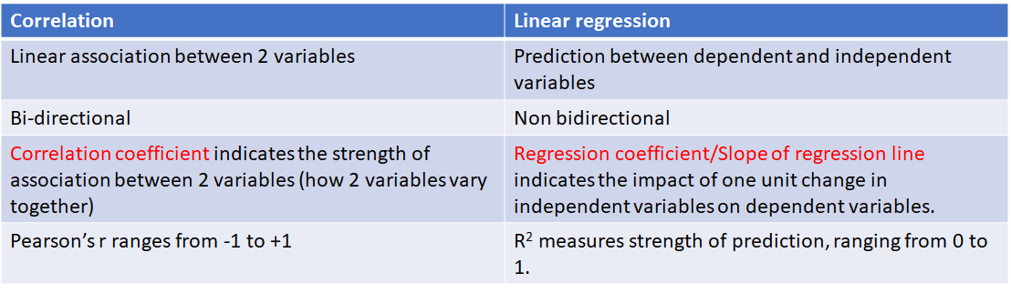
Prediction: Not Association

Slide 47
Prediction: Concepts
Variance: The average amount of variability between observed scores and the mean. Can be referred to as ‘sums of squares’ (SS), and there are different types of sums of squares in regression models (SStotal = SSreg + SSres)
Standard deviation: Square root of the variance
Correlation Coefficient: Standardised covariance coefficient.
Covariance: An unstandardised measure of calculating how much two variables vary together.
Standardised measures are typically more informative- since they are interpretable in terms of standard deviation opposed to the raw metric.

Slide 48
Prediction: Linear Regression
The Full simple linear regression line is expressed as:
Y = a + bX + e
Y is the dependent variable (predicted)
X is the independent variable (predictor)
a is the intercept of the line
b is the slope of the linear function- and indicates the direction of the relationship between variables.
And e is the ‘error’ term- also called residual.

Slide 49
Prediction: Linear Regression
The simplified linear regression line is written as
Y(hat) = a + bX
There aren’t any error terms in the simplified linear regression line because Y(hat) refers to the predicted value of the dependent variable. In other words, Y = Y(hat) + error

Slide 50
Prediction: Least Squares Regression
We will be using Ordinary Least Squares (OLS) regression for estimating our regression line.
What OLS regression does is minimise the value of the error terms- or to minimise the sums of squares of residuals (minimising the proportion of variance attributed to residuals)

Slide 51
Prediction: Multiple Linear Regression
Y = a + b1X1 + b2X2 + b3X3 + … + bnXn + e
Similar to the simple regression line, but with multiple independent variables
B1, b2, b3, …, bn: partial regression coefficient: indicates the expected change in Y for a unit of change in an IV, holding other IVs constant.
Notes:
Independent variables (IV) like to vary with each other- this can lead to difficulties in inferring a direction of causality. If we say that B predicts A in a model where B and C are very highly correlated, the reality could be that C predicts A, but it appears that B predicts A because we’re not considering C’s influence on B and A.
The notion of ‘partialling’ out variables is to hold other variables constant- to ensure that they don’t vary while we vary the IV of interest. By doing so, we can infer the predictive effect of that IV, holding constant all other IVs.

Slide 52
Prediction: R-squared
R-squared (Coefficient of determination) is the proportion of variance explained by the regression model (SSreg/SStotal).
It is a method to assess the strength of the complete regression model (all IVs are taken into consideration).
Another important aspect to consider is that SStotal is additively decomposed, SSreg + SSres will always equal to SStotal.

Slide 53
Prediction: R-squared considerations
R-squared is not the same thing as adjusted R-squared.
The computed R-squared statistic may be biased if:
There are a large amount of predictors,
There is a small sample size.
The adjusted R-squared returns a less biased statistic of the R-squared, so pay attention if the model has a large amount of IVs and a small sample size.

Slide 54
Prediction: Strength of IVs
Standardised regression coefficients: by using standardised data instead of data in its own metric, we can evaluate our model in terms of standard deviation and can allow you to compare strengths of multiple IVs- since they’re now on the same metric: SD.
Semi-partial correlation: the correlation between the chosen IV and the DV, holding all other IVs constant.
Squared semi-partial correlation: The proportion of variance the chosen IV explains in the DV, holding all other IVs constant.

Slide 55
Prediction: Statistical Assumptions
Independence of observations: one participant’s scores are observed and recorded independently of other participants.
Linearity. Linearity between the predictors and the predicted variable (multiple IVs and the one DV)
Homoscedasticity (Constant residual variance): errors vary independently (errors aren’t associated to IVs).
Normality of residuals. We’d like our residuals to be normally distributed.

Slide 56
Homoscedasticity
Breusch-Pagan test assumes the constant residuals scores → so we would like to see a big value of p for this null hypothesis test.

Slide 57
Prediction MCQ
For the following regression equation, which option is incorrect?
Y = 2.6 – 0.41X₁ + 0.51X₂
When X₁ increases by 1 and X₂ increases by 1, Y will increase by 0.10
The value of Y is 2.6 when scores on all independent variables are zero
Holding the scores on X₁ constant, 1 unit increase in X₂ predicts 0.51 unit increase in Y.
Holding the scores on X₂ constant, 2 units decrease in X₁ predicts 0.82 unit increase in Y.

Slide 58
Prediction MCQ Answer
For the following regression equation, which option is incorrect?
Y = 2.6 – 0.41X₁ + 0.51X₂
When X₁ increases by 1 and X₂ increases by 1, Y will increase by 0.10
The value of Y is 2.6 when scores on all independent variables are zero
Holding the scores on X₁ constant, 1 unit increase in X₂ predicts 0.51 unit increase in Y.
Holding the scores on X₂ constant, 2 units decrease in X₁ predicts 0.82 unit increase in Y.

Slide 59
2. Which of the following is not an assumption of a multiple linear regression model?
All observed scores are recorded independently
Residuals scores are normally distributed
Residual scores are constant
Predictors are linearly correlated with each other.

Slide 60
2. Which of the following is not an assumption of a multiple linear regression model?
All observed scores are recorded independently
Residuals scores are normally distributed
Residual scores are constant
Predictors are linearly correlated with each other.

Slide 61
3. Which of the following description is closest to the concept of heteroscedasticity?
Constant residual variance on different predicted values of the dependent variable.
Non-constant residual variance on different values of independent variables.
Residuals are distributed equally above and below zero.
Residuals are not distributed equally above and below zero.

Slide 62
3. Which of the following description is closest to the concept of heteroscedasticity?
Constant residual variance on different predicted values of the dependent variable.
Non-constant residual variance on different values of independent variables.
Residuals are distributed equally above and below zero.
Residuals are not distributed equally above and below zero.

Slide 63
4. In which of the following conditions should the adjusted R squared be used?
Sample size and the number of IVs are large
sample size and the number of IVs are small
R-square statistic is computed repeatedly
Sample size is small and number of IVs are large

Slide 64
4. In which of the following conditions should the adjusted R squared be used?
Sample size and the number of IVs are large
sample size and the number of IVs are small
R-square statistic is computed repeatedly
Sample size is small and number of IVs are large

Slide 65
5. Which of the following is the best interpretation if an IV has a 0.3 squared semi-partial correlation?
The correlation coefficient between the IV and DV is 0.3
For one unit increase in IV, there will be 0.3 units increase in DV
The IV uniquely explains 30% of the variation in DV, holding other IVs constant
The IV uniquely explains 30% of the variation in DV

Slide 66
5. Which of the following is the best interpretation if an IV has a 0.3 squared semi-partial correlation?
The correlation coefficient between the IV and DV is 0.3
For one unit increase in IV, there will be 0.3 units increase in DV
The IV uniquely explains 30% of the variation in DV, holding other IVs constant
The IV uniquely explains 30% of the variation in DV

Slide 67
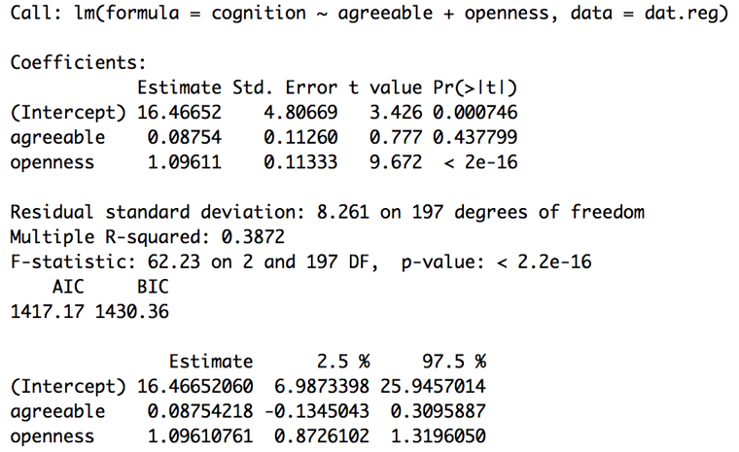
6. Which of the following sentences is the most correct interpretation of the following analysis?
Openness is a statistically significantly stronger predictor of ”need for cognition” than agreeableness
Agreeableness is a significant predictor of cognition
The data is consistent with zero prediction by agreeableness
Openness is a strong predictor of cognition

Slide 68
6. Which of the following sentences is the most correct interpretation of the following analysis?
Openness is a statistically significantly stronger predictor of ”need for cognition” than agreeableness
Agreeableness is a significant predictor of cognition
The data is consistent with zero prediction by agreeableness
Openness is a strong predictor of cognition

Slide 69
GROUP DIFFERENCES

Slide 70
How can mutually-exclusive groups be distinguished from mutually-paired groups?
Participants can belong to more than one group in mutually-exclusive design
Participants can belong to only one group in mutually-exclusive groups
Participants can belong to only one group in mutually-paired groups
Participants can belong to more than one group in mutually-paired design

Slide 71
How can mutually-exclusive groups be distinguished from mutually-paired groups?
Participants can belong to more than one group in mutually-exclusive design
Participants can belong to only one group in mutually-exclusive groups
Participants can belong to only one group in mutually-paired groups
Participants can belong to more than one group in mutually-paired design

Slide 72
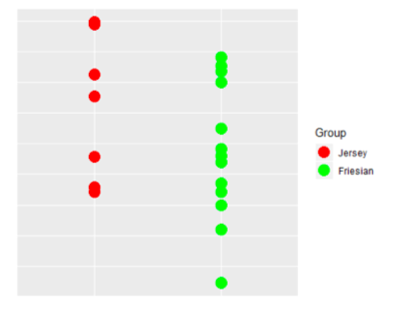
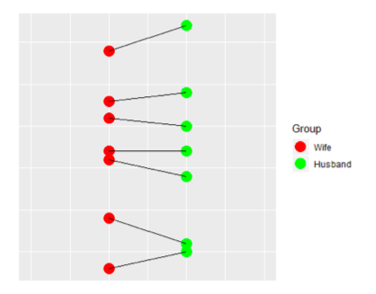
Two mutually-exclusive groups
each score in one group is independent of all scores in the other group
participants can only belong to one group
the size of each group does not necessarily have to be the same
Two mutually-paired groups
each score in one group is linked to one particular score in the other group
same person being measured twice
two people having a common dependency
the size of each group must be the same by design

Slide 73
Which of the following indicates assumptions of the mean difference between two dependent groups?
Normality of observed scores and homogeneity of variances
Homogeneity of variances and independence of observations
Independence of observations and normality of difference scores
Normality of difference scores, homogeneity of variances and independence of observations

Slide 74
Which of the following indicates assumptions of the mean difference between two dependent groups?
Normality of observed scores and homogeneity of variances
Homogeneity of variances and independence of observations
Independence of observations and normality of difference scores
Normality of difference scores, homogeneity of variances and independence of observations

Slide 75
Which of the following is not an assumption of the mean difference between two independent groups?
Normality of observed scores
Independence of observations
A balanced/ unbalanced design
Group variances are the same

Slide 76
Which of the following is not an assumption of the mean difference between two independent groups?
Normality of observed scores
Independence of observations
A balanced/ unbalanced design
Group variances are the same
The balanced/ unbalanced design influences the robustness of confidence intervals when homogeneity of variances is violated.
Notes:
A balanced design, unless variances are very different, protects against violation of homogeneity of variance assumption and inferences will be robust.
An unbalanced designed with a mild heterogeneity of variance influences the robustness of confidence intervals.

Slide 77
Assumptions for mean differences between two INDEPENDENT GROUPS
Observations are independent
Observed scores on the construct measure are normally distributed
Variances in two groups are the same
Assumptions for mean differences between two DEPENDENT GROUPS
Observations are independent
Observed scores on the construct measure are normally distributed
Homogeneity of variance assumption is not relevant because the analysis is undertaken on the different scores

Slide 78
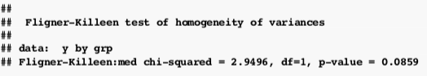
An independent samples t-test (n=250) was conducted, and result for homogeneity of variances was assessed. Is this result meaningful?
Yes. p-value is large (p> .05), so we fail to reject the null
B. Yes, p-value is small (p< .05), so we fail to reject the null
C. Yes, p-value is large (p> .05), so we reject the null
D. No, there is not enough information

Slide 79
An independent samples t-test (n=250) was conducted, and result for homogeneity of variances was assessed. Is this result meaningful?
Yes. p-value is large (p> .05), so we fail to reject the null
B. Yes, p-value is small (p< .05), so we fail to reject the null
C. Yes, p-value is large (p> .05), so we reject the null
D. No, there is not enough information
Notes:
In Fligner-Killeen’s test:
H0: The variances of the groups are equal.
Ha: The variances of the groups are not equal.
We got a p-value of .08, which is larger than α= .05 (i.e., our predefined criterion value). So we will consider our p-value to be large.
A larger p-value indicates a higher probability of getting the F-statistic we got (or one larger), assuming the null hypothesis is true.
So, we don’t have evidence to reject our initial assumption, i.e., H0 that the variances of the groups are equal. We don’t have sufficient evidence to reject our assumption of equal variances.

Slide 80
A dummy variable is used as an independent variable in a regression model when
the variable involved is numerical
the variable involved is categorical
when two independent variables interact
none of the above

Slide 81
A dummy variable is used as an independent variable in a regression model when
the variable involved is numerical
the variable involved is categorical
when two independent variables interact
none of the above
→ dummy variables are used to incorporate categorical variables into a meaningful set in a model

Slide 82
If a categorical independent variable contains two categories, then _________ dummy variable(s) will be needed to uniquely represent these categories
1
2
3
4

Slide 83
If a categorical independent variable contains two categories, then _________ dummy variable(s) will be needed to uniquely represent these categories
1
2
3
4
→ the dummy variable will contain 2 values, one for each category

Slide 84
OMNIBUS INVESTIGATIONS
null hypothesis focuses on all group means are the same
does not inform which groups differ
FOCUSED INVESTIGATIONS
specific clear research questions
provide identifiable differences
include explanations for omnibus approach

Slide 85
One way within subject ANOVA
Differences between 3 or more dependent groups or one group with multiple levels. All the assumptions of two dependent group design also apply here.
Omnibus approach vs Focused research question
Notes:
Omnibus approach checks if there is any difference among levels within subjects
Focused research questions looks at the overall change pattern over time by using orthogonal sets of contrast weights

Slide 86
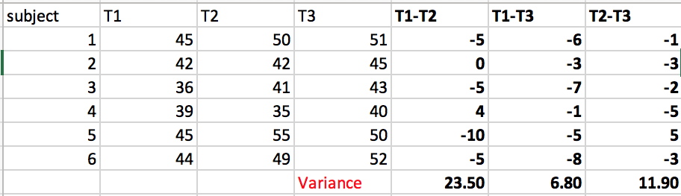
Assumption
Univariate approach: Sphericity
variances of all possible difference scores between pairs of 3 or more within subject conditions being homogeneous at a population level.

Slide 87
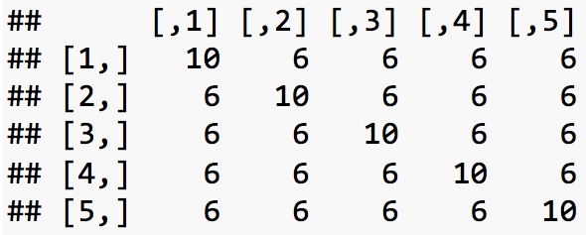
Assumption
This can be checked by looking at the covariance matrix to see if it has the same variance in each diagonal and off diagonal element → Compound symmetry
Sufficient but not necessary condition

Slide 88
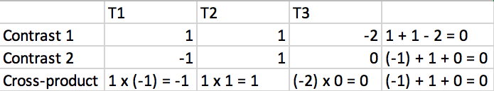
Focused research question
Contrast weights: weights of 2 comparison groups sum up to zero
Orthogonal: difference in each contrast is unique and does not overlap.
Contrast weights for each set sum up to zero
Cross-products of corresponding weights from 2 linear contrasts sum up to zero
The number of orthogonal contrast weights = the number of levels/cases - 1

Slide 89
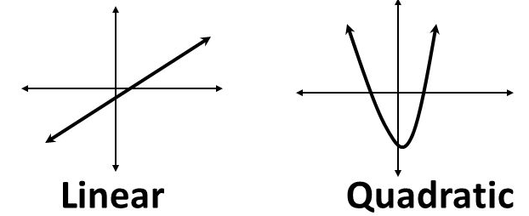
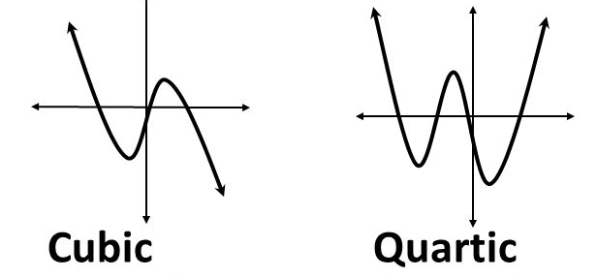
Using polynomial orthogonal contrasts to break down observed change over time into polynomial patterns of change over time: linear, quadratic, cubic, quartic, etc.

Slide 90
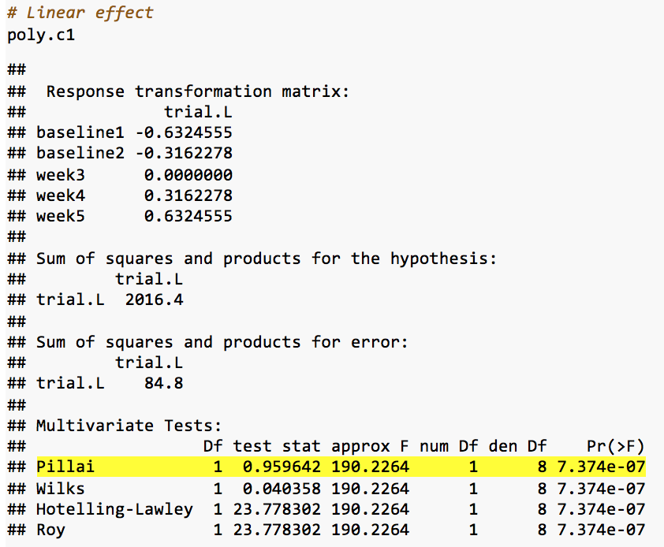

Slide 91
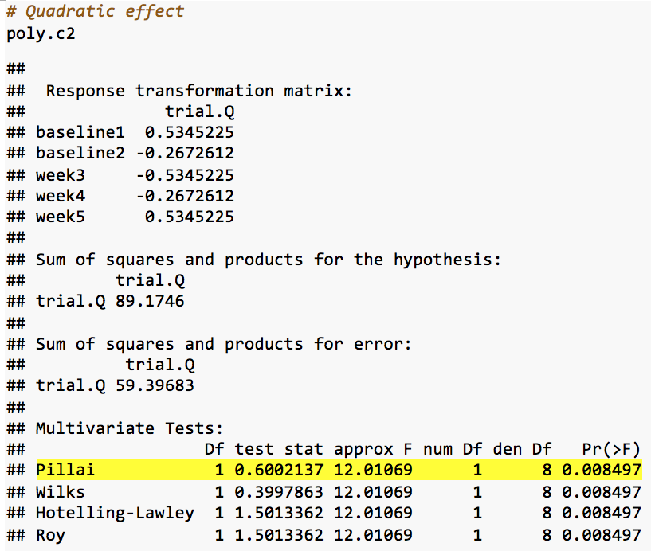

Slide 92
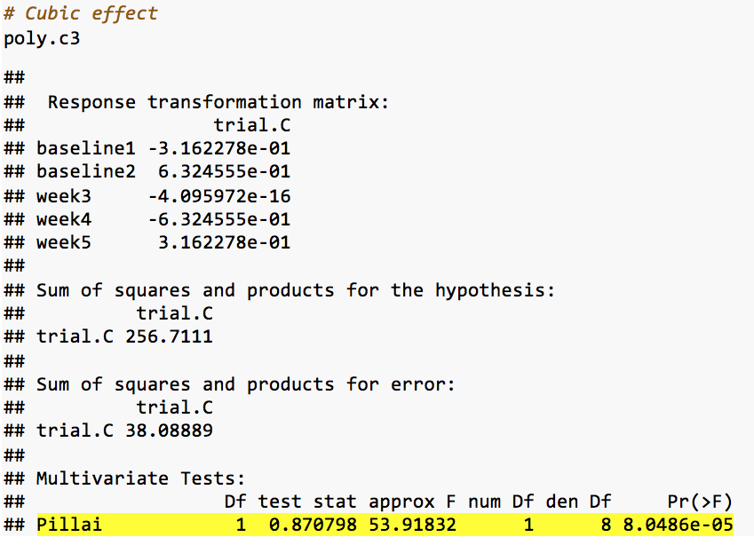

Slide 93
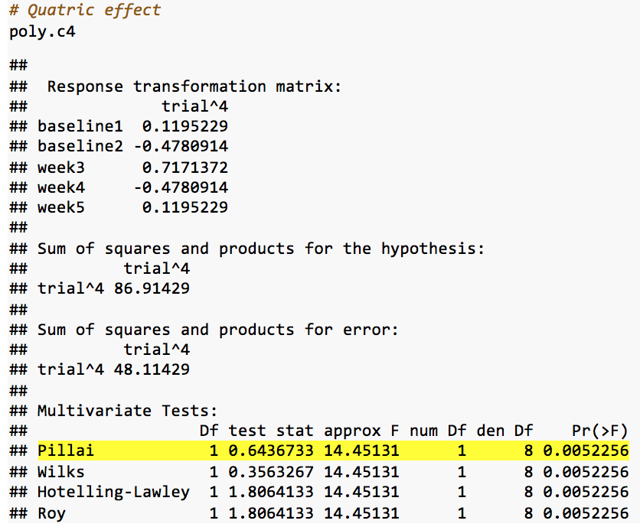

Slide 94
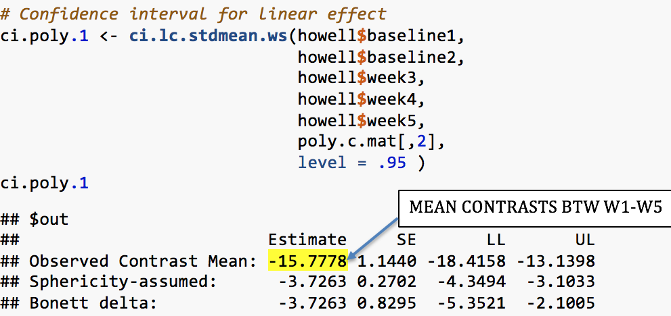
Confidence interval
The effects for quadratic, cubic and quartic is not readily understandable as the linear effects.

Slide 95
Two way ANOVA
Traditional ANOVA approach to 2 way design examines omnibus hypothesis.
1. Is there a difference between schizophrenia and schizophreniform disorder in negative symptoms at remission in young people with a first psychotic disorder?
2. Is there a difference between non-affective psychotic disorder and bipolar disorders in negative symptoms at remission in young people with a first psychotic disorder?
3. Is there a difference between males and females in negative symptoms at remission in young people with a first psychotic disorder?
4. Do any differences between schizophrenia and schizophreniform disorder in negative symptoms at remission in young people with a first psychotic disorder vary according to sex?
5. Do any difference between non-affective psychotic disorder and bipolar disorders in negative symptoms at remission in young people with a first psychotic disorder vary according to sex?

Slide 96
Factor A = Disorder (3 levels):
Sz: Schizophrenia Sf: Schizophreniform Bp: Bipolar Disorder with psychotic features
Factor B = Gender (2 levels):
Male Female
DV = Negative symptoms
Notes:
“Negative" symptoms are things that are "taken away" or reduced (e.g., reduced motivation or reduced intensity of emotion), as opposed to “positive” symptoms are changes in thoughts and feelings that are "added on" to a person's experiences (e.g., paranoia or hearing voices).
For the sake of understanding this week’s lab, it is perhaps easiest to loosely think of higher levels of continuously measured negative symptoms as indicating higher levels of unwellness.

Slide 97


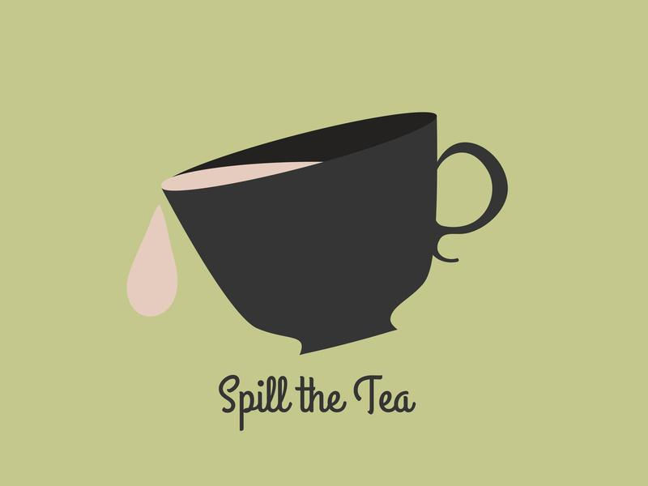
Main effect and Interaction effect
RQ 1, 2, 3 look at main effects of either sex or clinical diagnosis
RQ 4, 5 look at interaction between diagnosis and sex, above their main effects.

Slide 98

Cross-classified table
 | Sz | Sf | Bp | MarginalMeans | MarginalEffects
Males | 48.73 | 27.20 | 11.97
Females | 27.17 | 11.17 | 10.33
MarginalMeans
MarginalEffects

Slide 99
Means for each level of Sex irrespective of Diagnosis
 | Sz | Sf | Bp | MarginalMeans | MarginalEffects
Males | 48.73 | 27.20 | 11.97 | 29.30
Females | 27.17 | 11.17 | 10.33 | 16.22
MarginalMeans
MarginalEffects

Slide 100
 | Sz | Sf | Bp | MarginalMeans | MarginalEffects
Males | 48.73 | 27.20 | 11.97 | 29.30
Females | 27.17 | 11.17 | 10.33 | 16.22
MarginalMeans | 37.95 | 19.18 | 11.15
MarginalEffects
Means for each level of Diagnosis irrespective of Sex

Slide 101
 | Sz | Sf | Bp | MarginalMeans | MarginalEffects
Males | 48.73 | 27.20 | 11.97 | 29.30
Females | 27.17 | 11.17 | 10.33 | 16.22
MarginalMeans | 37.95 | 19.18 | 11.15 | 22.76
MarginalEffects
The grand mean for all cases

Slide 102
Each marginal mean minus the grand mean
 | Sz | Sf | Bp | MarginalMeans | MarginalEffects
Males | 48.73 | 27.20 | 11.97 | 29.30 | +6.54
Females | 27.17 | 11.17 | 10.33 | 16.22 | -6.54
MarginalMeans | 37.95 | 19.18 | 11.15 | 22.76
MarginalEffects | +15.19 | -3.58 | -11.61
Each marginal mean minus the grand mean

Slide 103
Cell mean = grand mean
+ marginal effect of Diagnosis
+ marginal effect of Sex
+ interaction effect of Sex and Diagnosis
 | Sz | Sf | Bp | MarginalMeans | MarginalEffects
Males | 48.73 | 27.20 | 11.97 | 29.30 | +6.54
Females | 27.17 | 11.17 | 10.33 | 16.22 | -6.54
MarginalMeans | 37.95 | 19.18 | 11.15 | 22.76
MarginalEffects | +15.19 | -3.58 | -11.61

Slide 104
To obtain the interaction effect for each cell, we need to remove the grand mean and the marginal effects of the two factors (i.e., Diagnosis and Sex).
 | Sz | Sf | Bp | MarginalMeans | MarginalEffects
Males | 48.73 | 27.20 | 11.97 | 29.30 | +6.54
Females | 27.17 | 11.17 | 10.33 | 16.22 | -6.54
MarginalMeans | 37.95 | 19.18 | 11.15 | 22.76
MarginalEffects | +15.19 | -3.58 | -11.61
Interaction effect for the first cell
48.73 – 22.76 – 15.19 – 6.54 = +4.24
Notes:
We play out in slow motion the process of obtaining the residual effects.

Slide 105
 | Sz | Sf | Bp | MarginalMeans | MarginalEffects
Males | +4.24 | +1.48 | -5.72 | 29.30 | +6.54
Females | -4.24 | -1.48 | +5.72 | 16.22 | -6.54
MarginalMeans | 37.95 | 19.18 | 11.15 | 22.76
MarginalEffects | +15.19 | -3.58 | -11.61

Slide 106
Main Effects Focused Research Questions
RQ 1: Is there a difference between schizophrenia and schizophreniform disorder in negative symptoms?
If we only had the factor of Diagnosis to consider:
Sz | Sf | Bp
Notes:
RQ abbreviated here slightly to ensure that it will fit properly on the slide. Full RQ: “Is there a difference between schizophrenia and schizophreniform disorder in negative symptoms at remission in young people with a first psychotic disorder?”
Deriving weights for the factor Diagnosis is no different to what you did in Week 8’s class.

Slide 107
Main Effects Focused Research Questions
RQ 1: Is there a difference between schizophrenia and schizophreniform disorder in negative symptoms?
If we only had the factor of Diagnosis to consider:
But we also have the factor Sex to consider, so:
Sz | Sf | Bp
+0.5 | -0.5 | 0
We have 6 cells in our design. Each cell needs a weight.
Sz | Sf | Bp
+0.5 | -0.5 | 0 | Males
+0.5 | -0.5 | 0 | Females
Notes:
Because this focussed RQ concerns the main effect of Diagnosis, the weights are simply copied across the rows (i.e., they are the same for the two levels of the factor Sex).

Slide 108
## Estimate SE LL UL
## Observed Mean Contrast: 18.7667 1.7794 15.2546 22.2787
## Hedges' g (Eq. Vars. Ass.): 1.9255 0.2097 1.5116 2.3394
## Bonett's d (Eq. Vars. Not Ass.): 1.9255 0.2244 1.4827 2.3683
##
## $coefs
## Sz Sf Bp Sz Sf Bp
## Contrast Coeff: 0.5 -0.5 0 0.5 -0.5 0

Slide 109
Main Effects Focused Research Questions
RQ 2: Is there a difference between the non-affective psychotic disorders and bipolar disorder?
If we only had the factor of Diagnosis to consider:
Sz | Sf | Bp
+0.25 | +0.25 | -0.5

Slide 110
Main Effects Focused Research Questions
RQ 2: Is there a difference between the non-affective psychotic disorders and bipolar disorder?
If we only had the factor of Diagnosis to consider:
But we also have the factor Sex to consider, so:
Sz | Sf | Bp
+0.25 | +0.25 | -0.5
Sz | Sf | Bp
+0.25 | +0.25 | -0.5 | Males
+0.25 | +0.25 | -0.5 | Females
Notes:
Because this focussed RQ concerns the main effect of Diagnosis, the weights are simply copied across the rows (i.e., they are the same for the two levels of the factor Sex).

Slide 111
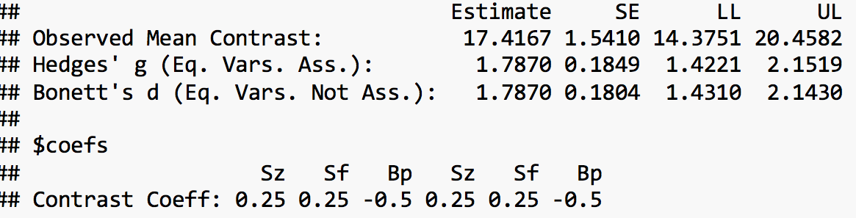

Slide 112
Main Effects Focused Research Questions
RQ 3: Is there a difference between males and females in negative symptoms?
If we only had the factor of Sex to consider:
+1 | Males
-1 | Females

Slide 113
Main Effects Focused Research Questions
RQ 3: Is there a difference between males and females in negative symptoms?
If we only had the factor of Sex to consider:
But we also have the factor Diagnosis to consider, so:
+1 | Males
-1 | Females
Sz | Sf | Bp
+1 | +1 | +1 | Males
-1 | -1 | -1 | Females
Notes:
Because this focussed RQ concerns the main effect of Sex, the weights are simply copied across the columns (i.e., they are the same for the three levels of the factor Diagnosis).

Slide 114
## Estimate SE LL UL
## Observed Mean Contrast: 13.0778 1.4529 10.2102 15.9454
## Hedges' g (Eq. Vars. Ass.): 1.3418 0.1655 1.0151 1.6685
## Bonett's d (Eq. Vars. Not Ass.): 1.3418 0.1691 1.0081 1.6755
##
## $coefs
## [,1] [,2] [,3] [,4] [,5] [,6]
## Contrast Coeff: 0.3333333 0.3333333 0.3333333 -0.3333333 -0.3333333 -0.3333333

Slide 115
Interaction Focused Research Questions
RQ 4: Do differences between schizophrenia and schizophreniform disorder in negative symptoms vary according to sex?
Notes:
RQ abbreviated here slightly to ensure that it will fit properly on the slide. Full RQ: “Do any differences between schizophrenia and schizophreniform disorder in negative symptoms at remission in young people with a first psychotic disorder vary according to sex?
Point out the word “vary” in this RQ. The word “vary” or “depend” in this context indicates that we are looking at a focused interaction research question.

Slide 116
Interaction Focused Research Questions
RQ 4: Do differences between schizophrenia and schizophreniform disorder in negative symptoms vary according to sex?
Sz | Sf | Bp
 |  |  |  | Males
 |  |  |  | Females
Notes:
The easiest way to do this is to initially derive weights for each factor before combining them.
If we first consider the factor Diagnosis, what would be an appropriate set of weights to test whether there is a difference between Sz and Sf? (revealed on the next slide…)

Slide 117
Interaction Focused Research Questions
RQ 4: Do differences between schizophrenia and schizophreniform disorder in negative symptoms vary according to sex?
Sz | Sf | Bp
+1 | -1 | 0
 |  |  |  | Males
 |  |  |  | Females

Slide 118
Interaction Focused Research Questions
RQ 4: Do differences between schizophrenia and schizophreniform disorder in negative symptoms vary according to sex?
Sz | Sf | Bp
+1 | -1 | 0
 |  |  | +1 | Males
 |  |  | -1 | Females
Notes:
For the factor Sex, there’s only two groups so only one possible comparison that can be made between groups.
[+1, -1] is an appropriate set of weights to make the comparison between Males and Females, though [-1, +1] or [+0.5, -0.5] would also be fine (not thinking about scaling of weights at this stage).

Slide 119
Interaction Focused Research Questions
RQ 4: Do differences between schizophrenia and schizophreniform disorder in negative symptoms vary according to sex?
Sz | Sf | Bp
+1 | -1 | 0
+1 × +1 | -1 × +1 | 0 × +1 | +1 | Males
+1 × -1 | -1 × -1 | 0 × -1 | -1 | Females
Notes:
To derive the cell weights for the interaction effect, for each cell we multiply its respective column and row weights together.

Slide 120
Interaction Focused Research Questions
RQ 4: Do differences between schizophrenia and schizophreniform disorder in negative symptoms vary according to sex?
Sz | Sf | Bp
+1 | -1 | 0
+1 | -1 | 0 | +1 | Males
-1 | +1 | 0 | -1 | Females

Slide 121
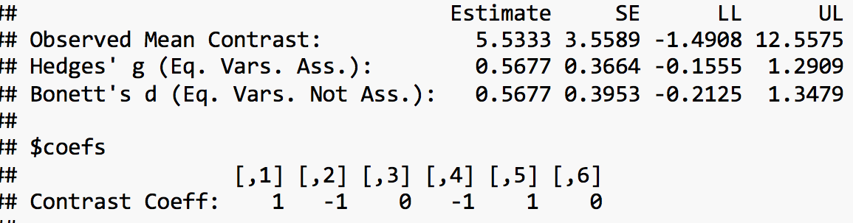

Slide 122
Interaction Focused Research Questions
RQ 5: Do differences between the non-affective psychotic disorders and bipolar disorder in negative symptoms vary according to sex?
Sz | Sf | Bp
 |  |  |  | Males
 |  |  |  | Females
Notes:
RQ abbreviated here slightly to ensure that it will fit properly on the slide. Full RQ: “Do any differences between the non-affective psychotic disorder and bipolar disorder in negative symptoms at remission in young people with a first psychotic disorder vary according to sex?

Slide 123
Interaction Focused Research Questions
RQ 5: Do differences between the non-affective psychotic disorders and bipolar disorder in negative symptoms vary according to sex?
Sz | Sf | Bp
+1 | +1 | -2
 |  |  |  | Males
 |  |  |  | Females

Slide 124
Interaction Focused Research Questions
RQ 5: Do differences between the non-affective psychotic disorders and bipolar disorder in negative symptoms vary according to sex?
Sz | Sf | Bp
+1 | +1 | -2
 |  |  | +1 | Males
 |  |  | -1 | Females

Slide 125
Interaction Focused Research Questions
RQ 5: Do differences between the non-affective psychotic disorders and bipolar disorder in negative symptoms vary according to sex?
Sz | Sf | Bp
+1 | +1 | -2
+1 × +1 | +1 × +1 | -2 × +1 | +1 | Males
+1 × -1 | +1 × -1 | -2 × -1 | -1 | Females

Slide 126
Interaction Focused Research Questions
RQ 5: Do differences between the non-affective psychotic disorders and bipolar disorder in negative symptoms vary according to sex?
Sz | Sf | Bp
+1 | +1 | -2
+1 | +1 | -2 | +1 | Males
-1 | -1 | +2 | -1 | Females

Slide 127
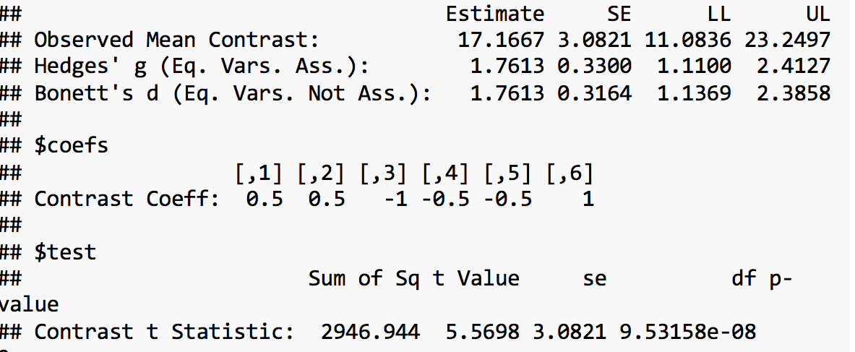

Slide 128
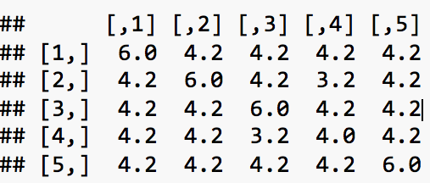
7. Which of the following is the most correct interpretation of the covariance matrix below?
There is not much variation in the covariance matrix, so we do not have enough evidence to conclude that sphericity is not being met
The variances are not the same in each diagonal and off diagonal element, so difference scores between pairs will be the heterogeneous at population level
The fact that compound symmetry is not present shows that sphericity is not violated
The variances are not the same in each diagonal and off diagonal element, so difference scores between pairs will be the heterogeneous at sample level

Slide 129
7. Which of the following is the most correct interpretation of the covariance matrix below?
There is not much variation in the covariance matrix, so we do not have enough evidence to conclude that sphericity is not being met
The variances are not the same in each diagonal and off diagonal element, so difference scores between pairs will be the heterogeneous at population level
The fact that compound symmetry is not present shows that sphericity is not violated
The variances are not the same in each diagonal and off diagonal element, so difference scores between pairs will be the heterogeneous at sample level

Slide 130
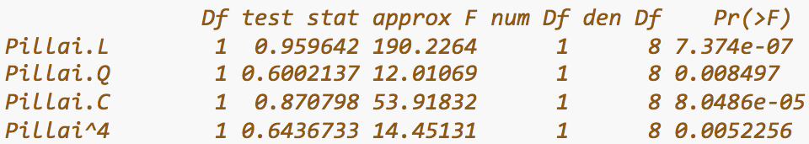
8. What is the best interpretation of the results below?
Because p is so small, the data is not consistent with non-zero linear, quadratic, cubic and quartic rates of change over time.
The value of p is small enough to conclude that the data is consistent with non-zero quadratic and quartic rates of change over time.
We can not make any conclusion from this result because confidence interval is not provided
P values are very small, so there is enough evidence to suggest that our data is consistent with the non-zero linear, quadratic, cubic and quartic rates of change over time.

Slide 131
8. What is the best interpretation of the results below?
Because p is so small, the data is not consistent with non-zero linear, quadratic, cubic and quartic rates of change over time.
The value of p is small enough to conclude that the data is consistent with non-zero quadratic and quartic rates of change over time.
We can not make any conclusion from this result because confidence interval is not provided
P values are very small, so there is enough evidence to suggest that our data is consistent with the non-zero linear, quadratic, cubic and quartic rates of change over time.
Notes:
E-07 = 10^ (-07)

Slide 132
9. What is true about main effects and interaction effects in between group subject design?
Interaction effects are the combination of all main effects.
Interaction effects are what’s left over after all the marginal effects are accounted for
While main effects are examined by using linear contrast weights, interaction effects are examined by using dummy coding.
Interaction effects are what’s left over after all the marginal effects and grand mean are accounted for

Slide 133
9. What is true about main effects and interaction effects in between group subject design?
Interaction effects are the combination of all main effects.
Interaction effects are what’s left over after all the marginal effects are accounted for
While main effects are examined by using linear contrast weights, interaction effects are examined by using dummy coding.
Interaction effects are what’s left over after all the marginal effects and grand mean are accounted for
Notes:
Dummy coding is used to transfer factor variable in R into dichotomous variables which can be meaningfully interpretable.

Slide 134
10. Given that marginal means and grand means are 40 and 10 respectively, calculate marginal effect.
4
-30
30
25

Slide 135
10. Given that marginal means and grand means are 40 and 10 respectively, calculate marginal effect.
4
-30
30
25
Notes:
Marginal effects = marginal mean - grand mean

Slide 136
11. Which of the following is most correct?
Planned comparison weights for main effects and interaction effects should sum up to zero
Planned comparison weights for main effects and interaction effects do necessarily sum up to zero
Planned comparison weights for main effects and interaction effects should be orthogonal
Planned comparison weights for main effects sum up to 1 while those for interaction effects should sum up to zero.

Slide 137
11. Which of the following is most correct?
Planned comparison weights for main effects and interaction effects should sum up to zero
Planned comparison weights for main effects and interaction effects do necessarily sum up to zero
Planned comparison weights for main effects and interaction effects should be orthogonal
Planned comparison weights for main effects sum up to 1 while those for interaction effects should sum up to zero.

Slide 138
12. If factor A has planned contrast (-2,+1,+1) and Factor B has planned contrast (2,-2), what are corresponding weights of contrast for interaction effect?
(-4,2,-2,4,-2,-2)
(4,-2,-2,4,-2,-2)
(-4,2,2,4,-2,-2)
(-4,2,-2,-4,2,2)

Slide 139
12. If factor A has planned contrast (-2,+1,+1) and Factor B has planned contrast (2,-2), what are corresponding weights of contrast for interaction effect?
(-4,2,-2,4,-2,-2)
(4,-2,-2,4,-2,-2)
(-4,2,2,4,-2,-2)
(-4,2,-2,-4,2,2)

Slide 140
PSYCHOLOGICAL
ASSESSMENT

Slide 141
Which is not an assumption of Classical test theory?
expected value of the error equals to 0
2𝐶𝑜𝑣(𝜏, 𝜖) = 0
errors associate with each other
expected mean of observed scores = expected mean of true scores

Slide 142
Which is not an assumption of Classical test theory?
expected value of the error equals to 0
2𝐶𝑜𝑣(𝜏, 𝜖) = 0
errors do not correlate with true scores
errors associate with each other
errors do not correlate with each other
Expected mean of observed scores = expected mean of true scores

Slide 143
As the degree of reliability increases,
error variance increases
variance of observed scores increases
variance of observed scores decreases
none of the above

Slide 144
As the degree of reliability increases,
error variance increases
variance of observed scores increases
variance of observed scores decreases
none of the above

Slide 145
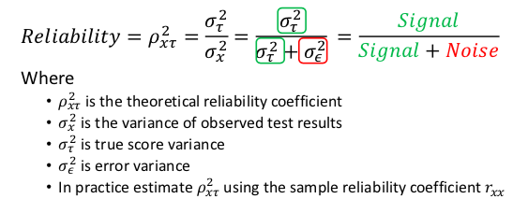
-> variance of observe test results decreases
-> error variance decreases -> increase reliability (we want to minimise the noise)

Slide 146
Which type of reliability is estimated by obtaining scores from two different tests on the same sample of people that measure same set of true scores and working out the correlation between them?
Alternate-form reliability
Split-half reliability
Test-retest reliability
None of the above

Slide 147
Which type of reliability is estimated by obtaining scores from two different tests on the same sample of people that measure same set of true scores and working out the correlation between them?
Alternate-form reliability
Split-half reliability
split your test into two parallel subtests & correlations
Test-retest reliability
obtain scores from the same sample of people on two different administrations of the same set of test items

Slide 148
A source of carryover effects may take the form of
participants lose interest and motivation to complete the test
memory effects from previous tests on the retests
test takers fail to return for the second test
all of the above

Slide 149
A source of carryover effects may take the form of
participants lose interest and motivation to complete the test
memory effects from previous tests on the retests
test takers fail to return for the second test
all of the above

Slide 150
The standard error of measurement
indicates the standard deviation of a distribution of observed test scores, obtained by one participant, under different administrations of the test
indicates the variance of observed test scores, obtained by one participant, under different administrations of the test
represents the mean differences of the sample
none of the above

Slide 151
The standard error of measurement
indicates the standard deviation of a distribution of observed test scores, obtained by one participant, under different administrations of the test
indicates the variance of observed test scores, obtained by one participant, under different administrations of the test
represents the mean differences of the sample
none of the above

Slide 152
The standard error of measurement
decreases when reliability decreases
increases when reliability increases
equals to 0 when reliability is perfect
equals to 0 when the test has no reliability

Slide 153
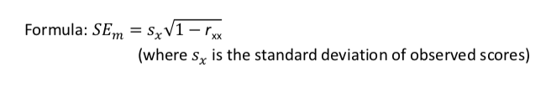
The standard error of measurement
decreases when reliability decreases
increases when reliability increases
equals to 0 when reliability is perfect
equals to 0 when the test has no reliability

Slide 154
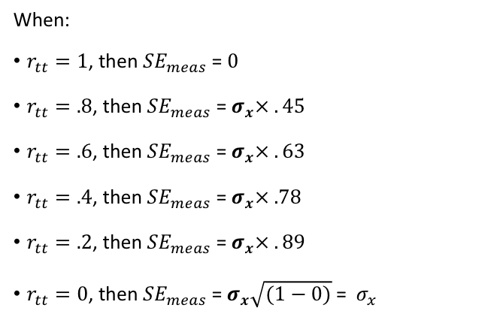
Reliability coefficient = 1
→ test has perfect reliability
→ indicates individual who take the test will always have the same score → SD of participants scores = 0
→ standard error of measurement = 0
Reliability coefficient = 0
→ test has completely no reliability
→ indicates SD of participants scores = SD of population

Slide 155
Given the population mean is 100 and the test’s reliability is .5, what is the participant’s predicted true score when the observed score was 150?
75
100
125
150

Slide 156
Given the population mean is 100 and the test’s reliability is .5, what is the participant’s predicted true score when the observed score was 150?
75
100
125
150

Slide 157
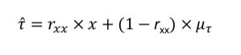
Predicted true scores
PTS = (.5 x 150) + (100 x (1 - .5))
= 125
Participant’s observed score
Population mean scores
Predicted true scores
Reliability coefficient

Slide 158
Given the standard error of measurement of IQ test is 25, one RMHI student obtains a predicted true score of 125. Approximately, what is the 95% confidence interval for this test score?
100 - 150
75 - 150
75 - 175
100 - 175

Slide 159
Given the standard error of measurement of IQ test is 25, one RMHI student obtains a predicted true score of 125. Approximately, what is the 95% confidence interval for this test score?
100 - 150
75 - 150
75 - 175
100 - 175

Slide 160
Standard error of estimation
Lower Bound: Predicted True Score − (1.96 × 𝑆𝐸 )
Upper Bound: Predicted True Score + (1.96 × 𝑆𝐸 )
Lower Bound = 125 − (1.96 × 25 ) = 76
Upper Bound = 125 + (1.96 × 25 ) = 174
95% CI [76, 174]

Slide 161
CONTENT
VALIDITY
A test has content validity to the extent its content reflects the full domain of the construct it is supposedly assessing
CRITERION
VALIDITY
A test has criterion validity to the extent that it can predict scores on relevant criterion variables
CONSTRUCT
VALIDITY
A test has construct validity to the extent it reflects the construct it is meant to be reflecting.
CONCURRENT
VALIDITY
PREDICTIVE
VALIDITY
FACE
VALIDITY
CONVERGENT
VALIDITY
DISCRIMINANT
VALIDITY

Slide 162
If the content of a test looks as though it is measuring what it is supposed to, it is said to have high
construct validity
face validity
predictive validity
discriminant validity

Slide 163
If the content of a test looks as though it is measuring what it is supposed to, it is said to have high
construct validity
face validity
predictive validity
discriminant validity

Slide 164
To assess the convergent validity of a new test of self-esteem, a researcher should establish that…
it correlates highly with a different test of self-esteem
it does not correlate too highly with a different test of self-esteem
it correlates highly with a test of narcissism
it does not correlate too highly with a test of narcissism

Slide 165
To assess the convergent validity of a new test of self-esteem, a researcher should establish that…
it correlates highly with a different test of self-esteem
→ convergent validity indicates test scores should be correlated with tests of related constructs
it does not correlate too highly with a different test of self-esteem
it correlates highly with a test of narcissism
→ discriminant validity indicates test scores should not highly correlated with tests of unrated constructs
it does not correlate too highly with a test of narcissism

Slide 166
To test the predictive validity of a test of extraversion, a researcher could show that people’s scores on the test correlate with …
their scores on another extraversion test
their scores on the same extraversion test at a later date
another person’s ratings of their extraversion
their frequency of attending parties over a two-month period

Slide 167
To test the predictive validity of a test of extraversion, a researcher could show that people’s scores on the test correlate with …
their scores on another extraversion test
their scores on the same extraversion test at a later date
another person’s ratings of their extraversion
their frequency of attending parties over a two-month period
→ predictive validity indicates test scores evaluated against a criterion that would be measured later
→ concurrent validity indicates test scores evaluated against a criterion measured at the same time

Slide 168
When care has been taken to ensure that a measure is measuring all aspects of something fully, it has high..
When a measure correlates highly with other established measures of the same thing, it has high..
When a measure is based on a full and close examination of the underlying concept, along with the related theoretical approaches, it has high..
construct validity
criterion validity
content validity
face validity
1a - 2b - 3c
1b - 2d - 3a
1c - 2b- 3a
1d - 2c - 3b

Slide 169
When care has been taken to ensure that a measure is measuring all aspects of something fully, it has high..
When a measure correlates highly with other established measures of the same thing, it has high..
When a measure is based on a full and close examination of the underlying concept, along with the related theoretical approaches, it has high..
construct validity
criterion validity
content validity
face validity
1a - 2b - 3c
1b - 2d - 3a
1c - 2b- 3a
1d - 2c - 3b

Slide 170
When care has been taken to ensure that a measure is measuring all aspects of something fully, it has high..
When a measure correlates highly with other established measures of the same thing, it has high..
When a measure is based on a full and close examination of the underlying concept, along with the related theoretical approaches, it has high..
construct validity
criterion validity
content validity
face validity
1a - 2b - 3c
1b - 2d - 3a
1c - 2b- 3a
1d - 2c - 3b

Slide 171
What’s the sensitivity?
A. healthy people testing positive/sick people testing positive
B. sick people testing positive/people testing positive
C. sick people testing positive/people with disease
D. people testing positive/total

Slide 172
What’s the sensitivity?
A. healthy people testing positive/sick people testing positive
B. sick people testing positive/people testing positive
C. sick people testing positive/people with disease
D. people testing positive/total

Slide 173
What’s the specificity?
A. healthy people testing positive/ people testing negative
B. sick people testing positive/people testing positive
C. sick people testing positive/sick people
D. healthy people testing negative/healthy people

Slide 174
What’s the specificity?
A. healthy people testing positive/ people testing negative
B. sick people testing positive/people testing positive
C. sick people testing positive/sick people
D. healthy people testing negative/healthy people

Slide 175
What’s the Positive Predictive Power?
A. healthy people testing positive/sick people testing positive
B. sick people testing positive/people testing positive
C. sick people testing positive/total
D. people testing positive/total

Slide 176
What’s the Positive Predictive Power?
A. healthy people testing positive/sick people testing positive
B. sick people testing positive/people testing positive
C. sick people testing positive/total
D. people testing positive/total

Slide 177
What’s the Negative Predictive Power?
A. sick people testing negative/ healthy people testing negative
B. well people testing negative/ people testing negative
C. well people testing negative/ total
D. people testing negative/ total

Slide 178
What’s the Negative Predictive Power?
A. sick people testing negative/ healthy people testing negative
B. well people testing negative/ people testing negative
C. well people testing negative/ total
D. people testing negative/ total

Slide 179
 | Criterion Positive | Criterion negative
Test Positive | a | b | PPP =a/(a + b) Probability a positive test result indicates a positive case
Test Negative | c | d | NPP= d/(c+d) Probability a negative test result indicates a negative case
 | Sensitivity Se = a/(a+c) Test’s ability to correctly detect positive cases | Specificity Sp = d/(b+d) Test’s ability to correctly detect negative cases
 | Prevalence= (a+c)/(a+b+c+d) Probability a random case from the study is criterion positive
Notes:
Test positive: there is a disease
Test negative: there is no disease
Criterion positive: there is a disease
Criterion negative: there is no disease

Slide 180
In attempt to estimate and evaluate validity evidence, which multitrait-multimethod correlation produces the highest reliability when research studies have several constructs and apply different methods?
heterotrait-heteromethod correlations
heterotrait-monomethod correlations
monotrait-heteromethod correlations
monotrait-monomethod correlations

Slide 181
In attempt to estimate and evaluate validity evidence, which multitrait-multimethod correlation produces the highest reliability when research studies have several constructs and apply different methods?
heterotrait-heteromethod correlations
heterotrait-monomethod correlations
monotrait-heteromethod correlations
monotrait-monomethod correlations

Slide 182
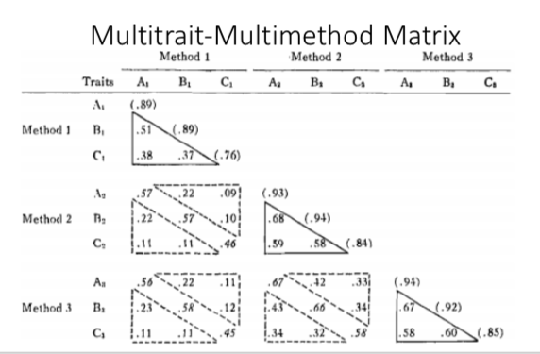
- one method measures the same trait → high correlations
→ convergent validity
different methods measure different constructs → weakest

Slide 183
Afterword
I’d also like to have you all think about these tools a bit in your own time.
Research tools are limited to the extent of the researcher’s goals and ability to communicate them.
Believe me or not, I feel that understanding these tools are the easy part- communicating them and describing what they mean in practical terms take even more practice! And I’d argue that proper communication and understanding of these tools are immensely important in any piece of research.

Slide 184
Afterword
We’ve gone through a LOT in a short amount of time.
Don’t let anyone tell you otherwise, these concepts take time and practice to understand.
Thank you everyone for listening and give yourselves a pat on the back!

Slide 185
Resources
You bet I’ll list a bunch of things here that I find awesome:
Learning Statistics with R. I find Danielle Navarro’s communication style an absolute treat to read- 100% worth your time!
Andy Field. He’s got a bunch of titles for SPSS/SAS/R and again, he’s got a wonderful communication style.
Anything in R: https://bookdown.org/
Thank Amy Perfors for this one- https://psychologicalsciences.unimelb.edu.au/research/hubs/chdh/ccs/resources-and-readings
I’ve got a bit more varied stuff, come have a chat with me!

Slide 186
We’d very much appreciate your feedback!
We’d really appreciate it if you could fill out this google form for feedback regarding the session we’ve just held.
https://bit.ly/2IHVd4Z
These slides will be available at
http://github.com/jjanuar/rmhipals2019

